Slide 1
201027_Numerical Aperture of Optical Fibre
Engineering Physics Laboratory

Slide 2
AIM
To find the numerical aperture of a given optic fibre and hence to find its acceptance angle.

Slide 3
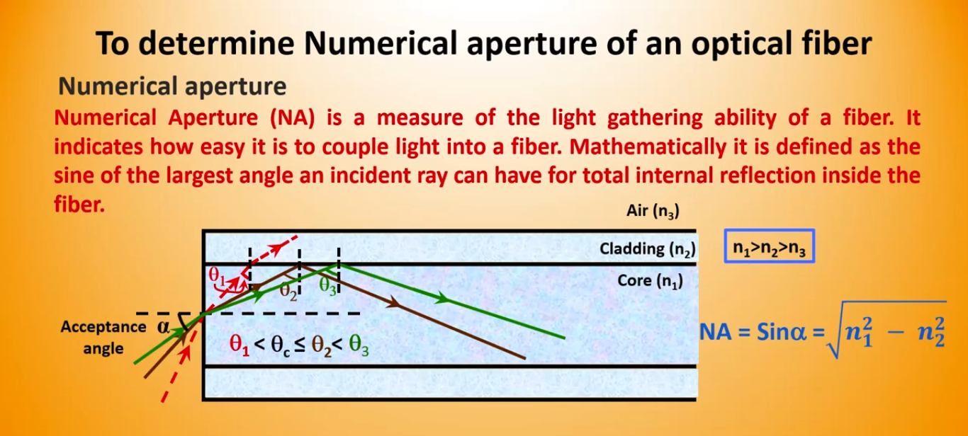
Numerical Aperture

Slide 4


Theory
Numerical Aperture
NA= Sin θ_{a}
where θa, is called acceptance cone angle.
Let the spot size of the beam at a distance d (distance between the fiber end and detector) as the radius of the spot(r). Then,

Slide 5
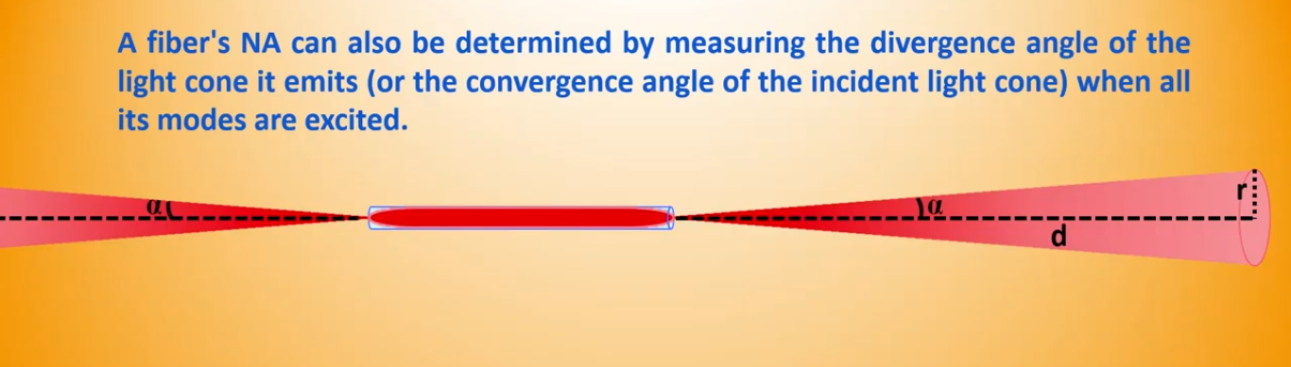

Slide 6
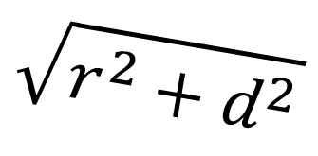
Derivation
$$\sqrt{r^{2}+d^{2}}$$
r
θ
r
θ
d

Slide 7
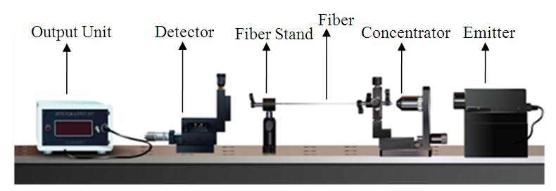
APPARATUS

Slide 8
VIRTUAL Experiment Link
http://vlab.amrita.edu/?sub=1&brch=189&sim=343&cnt=1

Slide 9
VIRTUAL Experiment

Slide 10
Variables

Slide 11
Observation
S. No. | Distance (X) mm | I µA
1
2
3
4
5
6
7

Slide 12
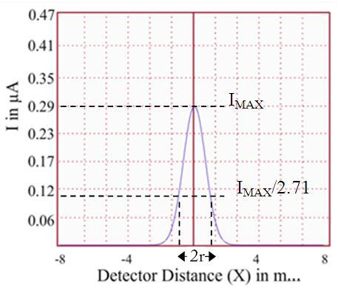
Graph

Slide 13


Calculations
Distance between the fiber and the detector, d = …………………………… m
Radius of the spot, r =……………………….. m
Numerical Aperture of the optic fiber, sin(θ) = = ..................
Acceptance angle, θ= = ...........................

Slide 14
Results
Numerical aperture of the optic fiber is = …………………
Angle of acceptance = ……………….

